Slide 1

DATA STRUCTURES USING C
22BCA2C05
UNIT 2

Slide 2


Slide 3
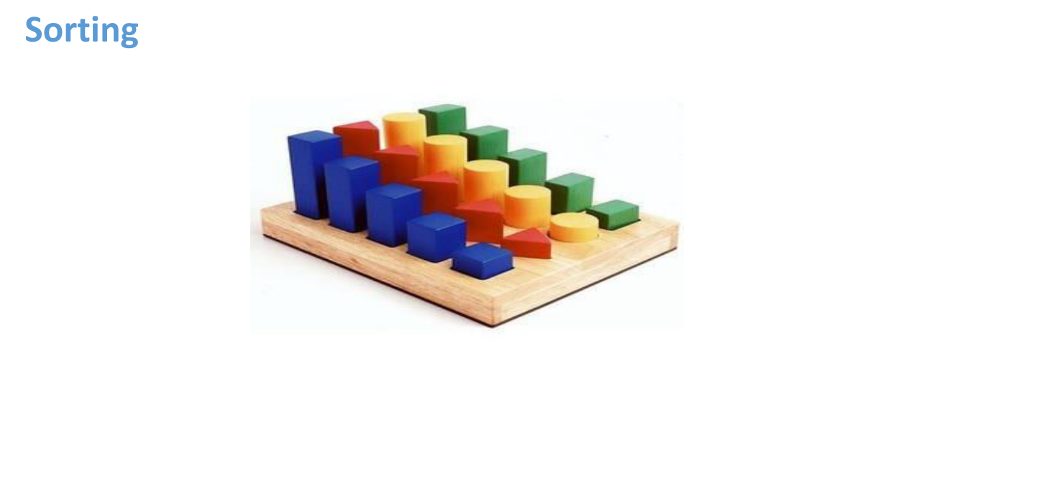

Slide 4


Slide 5
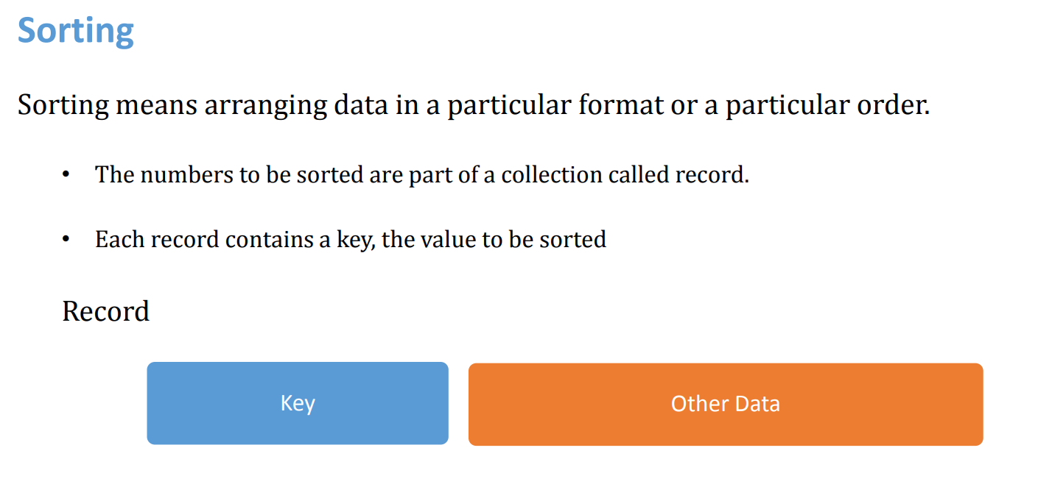

Slide 6
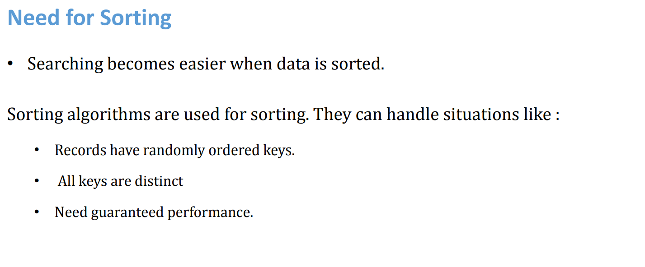

Slide 7
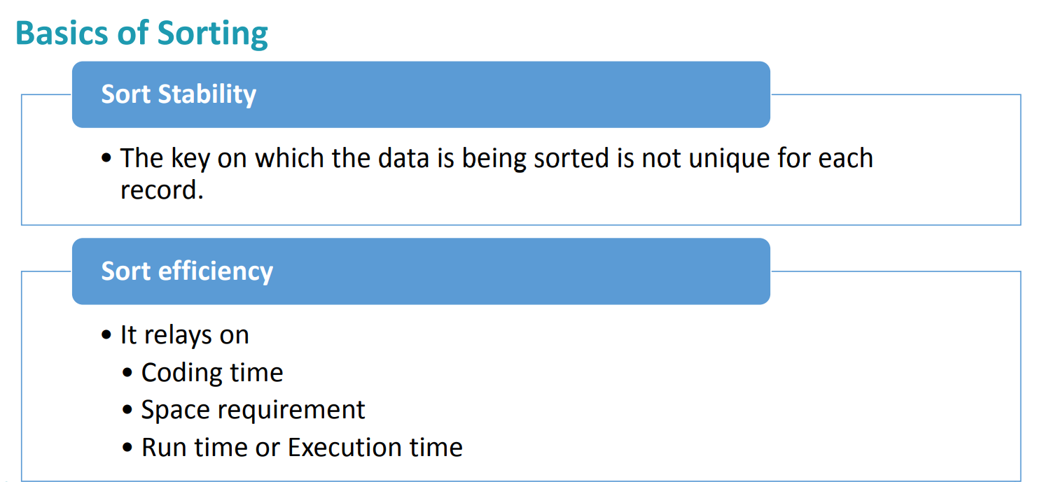

Slide 8
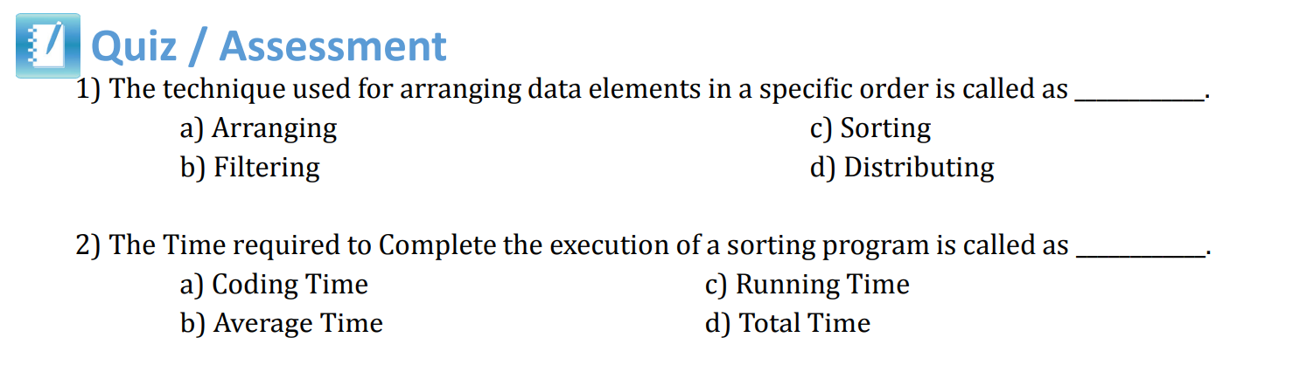

Slide 9
Sorting
Bubble sort, Selection sort, Insertion sort, Merge sort, Quick sort

Slide 10
Bubble Sort
Bubble sort is a simple sorting algorithm. This sorting algorithm is a comparison-based algorithm in which each pair of adjacent elements is compared and the elements are swapped if they are not in order.

Slide 11
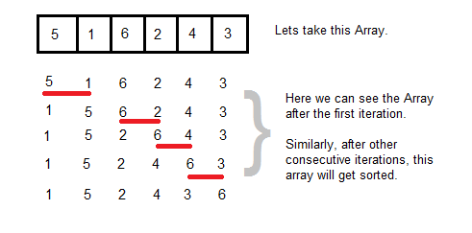
Sorting Techniques
Bubble and Insertion Sort Algorithms with Example
Bubble Sort - Example

Slide 12
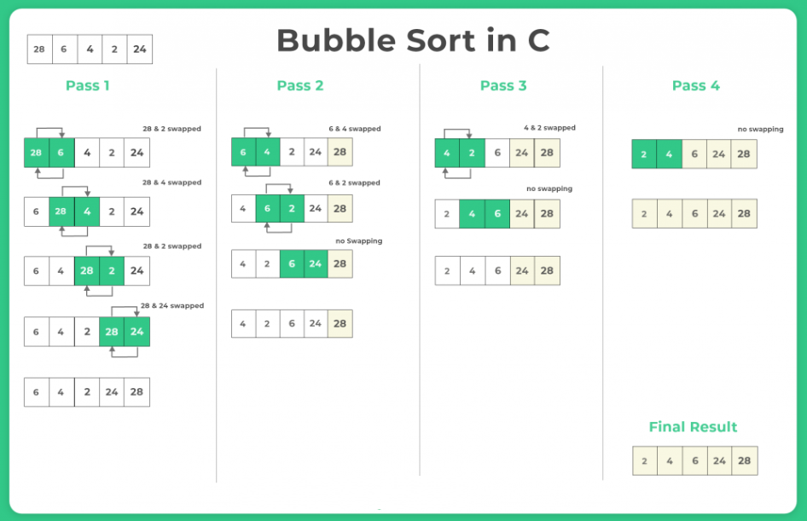

Slide 13
Algorithm
begin BubbleSort(arr)
for all array elements
if arr[i] > arr[i+1]
swap(arr[i], arr[i+1])
end if
end for
return arr
end BubbleSort

Slide 14
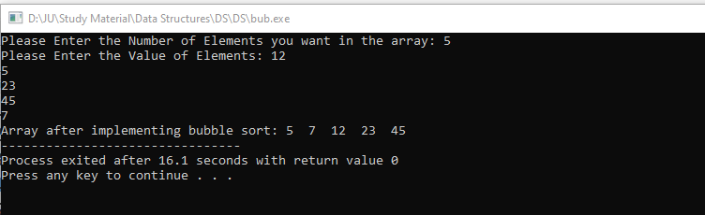
Implementation of Bubble sort
#include <stdio.h>
int main(){
int arr[50], num, x, y, temp;
printf("Please Enter the Number of Elements you want in the array: ");
scanf("%d", &num);
printf("Please Enter the Value of Elements: ");
for(x = 0; x < num; x++)
scanf("%d", &arr[x]);
for(x = 0; x < num - 1; x++){
for(y = 0; y < num - x - 1; y++){
if(arr[y] > arr[y + 1]){
temp = arr[y];
arr[y] = arr[y + 1];
arr[y + 1] = temp;
}
}
}
printf("Array after implementing bubble sort: ");
for(x = 0; x < num; x++){
printf("%d ", arr[x]);
}
return 0;
}

Slide 15
Selection sort
Selection sort is a simple sorting algorithm.
This sorting algorithm is an in-place comparison-based algorithm in which the list is divided into two parts, the sorted part at the left end and the unsorted part at the right end. Initially, the sorted part is empty and the unsorted part is the entire list.
comparison-based algorithm
The unsorted part at the right end
The sorted part at the left end
Selection sort is generally used when -
A small array is to be sorted
Swapping cost doesn't matter
It is compulsory to check all elements

Slide 16




Working Algorithm
Let the elements of the array are
For the first position in the sorted list, the whole list is scanned, and find that 10 is the lowest value.
So we replace 14 with 10. After one iteration 10, which happens to be the minimum value in the list, appears in the first position of the sorted list.
For the second position, where 33 is residing, we start scanning the rest

Slide 17
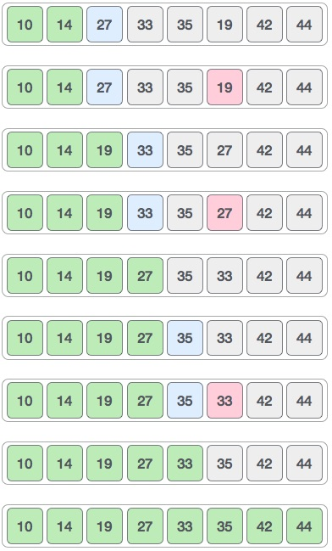

We find that 14 is the second lowest value in the list and it should appear at the second place. We swap these values.
The same process is applied to the rest of the items in the array.
Notes:
https://www.javatpoint.com/selection-sort

Slide 18

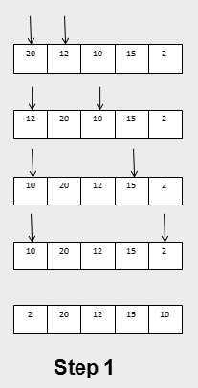
Sorting Techniques
Bubble and Insertion Sort Algorithms with Example
Selection Sort Algorithm
Selection sort algorithm starts by comparing first two elements of that array and swap the elements if required
Then, again first element and third element are compared and swapped if required.
This process will continue until first and last element of that array is compared, thus completing the first pass of selection sort.

Slide 19
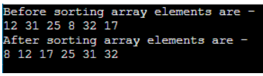
#include <stdio.h>
void selection(int arr[], int n)
{
int i, j, small;
for(i=0;i<n-1; i++) // One by one move boundary of unsorted subarray
{
small = i; //minimum element in unsorted array
for (j = i+1; j < n; j++)
if (arr[j] < arr[small])
small = j;
// Swap the minimum element with the first element
int temp = arr[small];
arr[small] = arr[i];
arr[i] = temp;
} }
void printArr(int a[], int n) /* function to print the array */
{
int i;
for (i = 0; i < n; i++)
printf("%d ", a[i]);
}
int main()
{
int a[] = { 12, 31, 25, 8, 32, 17 };
int n = sizeof(a) / sizeof(a[0]);
printf("Before sorting array elements are - \n");
printArr(a, n);
selection(a, n);
printf("\nAfter sorting array elements are - \n");
printArr(a, n);
return 0; }

Slide 20
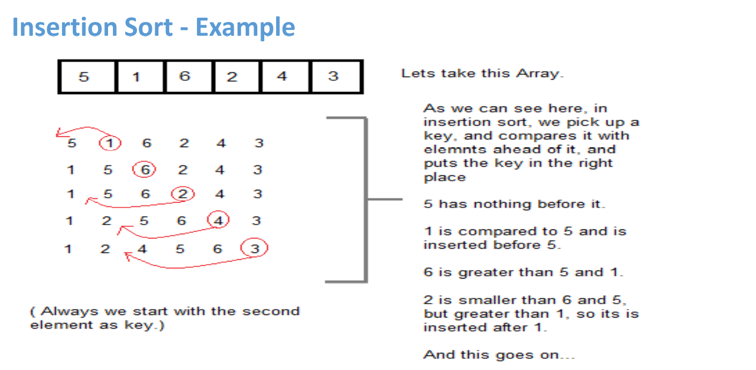
Insertion sort

Slide 21
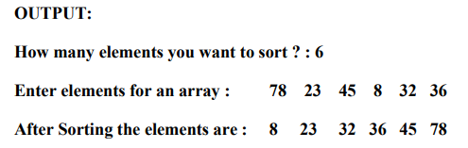
Insertion sort
#include<stdio.h>
#include<conio.h>
void main( )
{
int a[10],i,j,k,n;
clrscr( );
printf("How many elements you want to sort?\n");
scanf("%d",&n);
printf("\nEnter the Elements into an array:\n");
for (i=0;i<n;i++)
scanf("%d",&a[i]);
for(i=1;i<n;i++)
{
k=a[i];
for(j= i-1; j>=0 && k<a[j]; j--)
a[j+1]=a[j];
a[j+1]=k;
} printf("\n\n Elements after sorting: \n");
for(i=0;i<n;i++)
printf("%d\n", a[i]);
getch( );
}

Slide 22
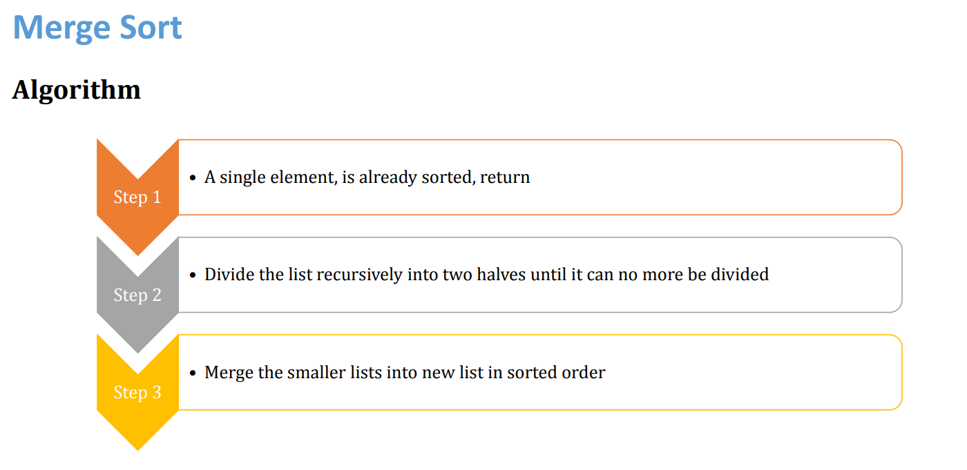

Slide 23
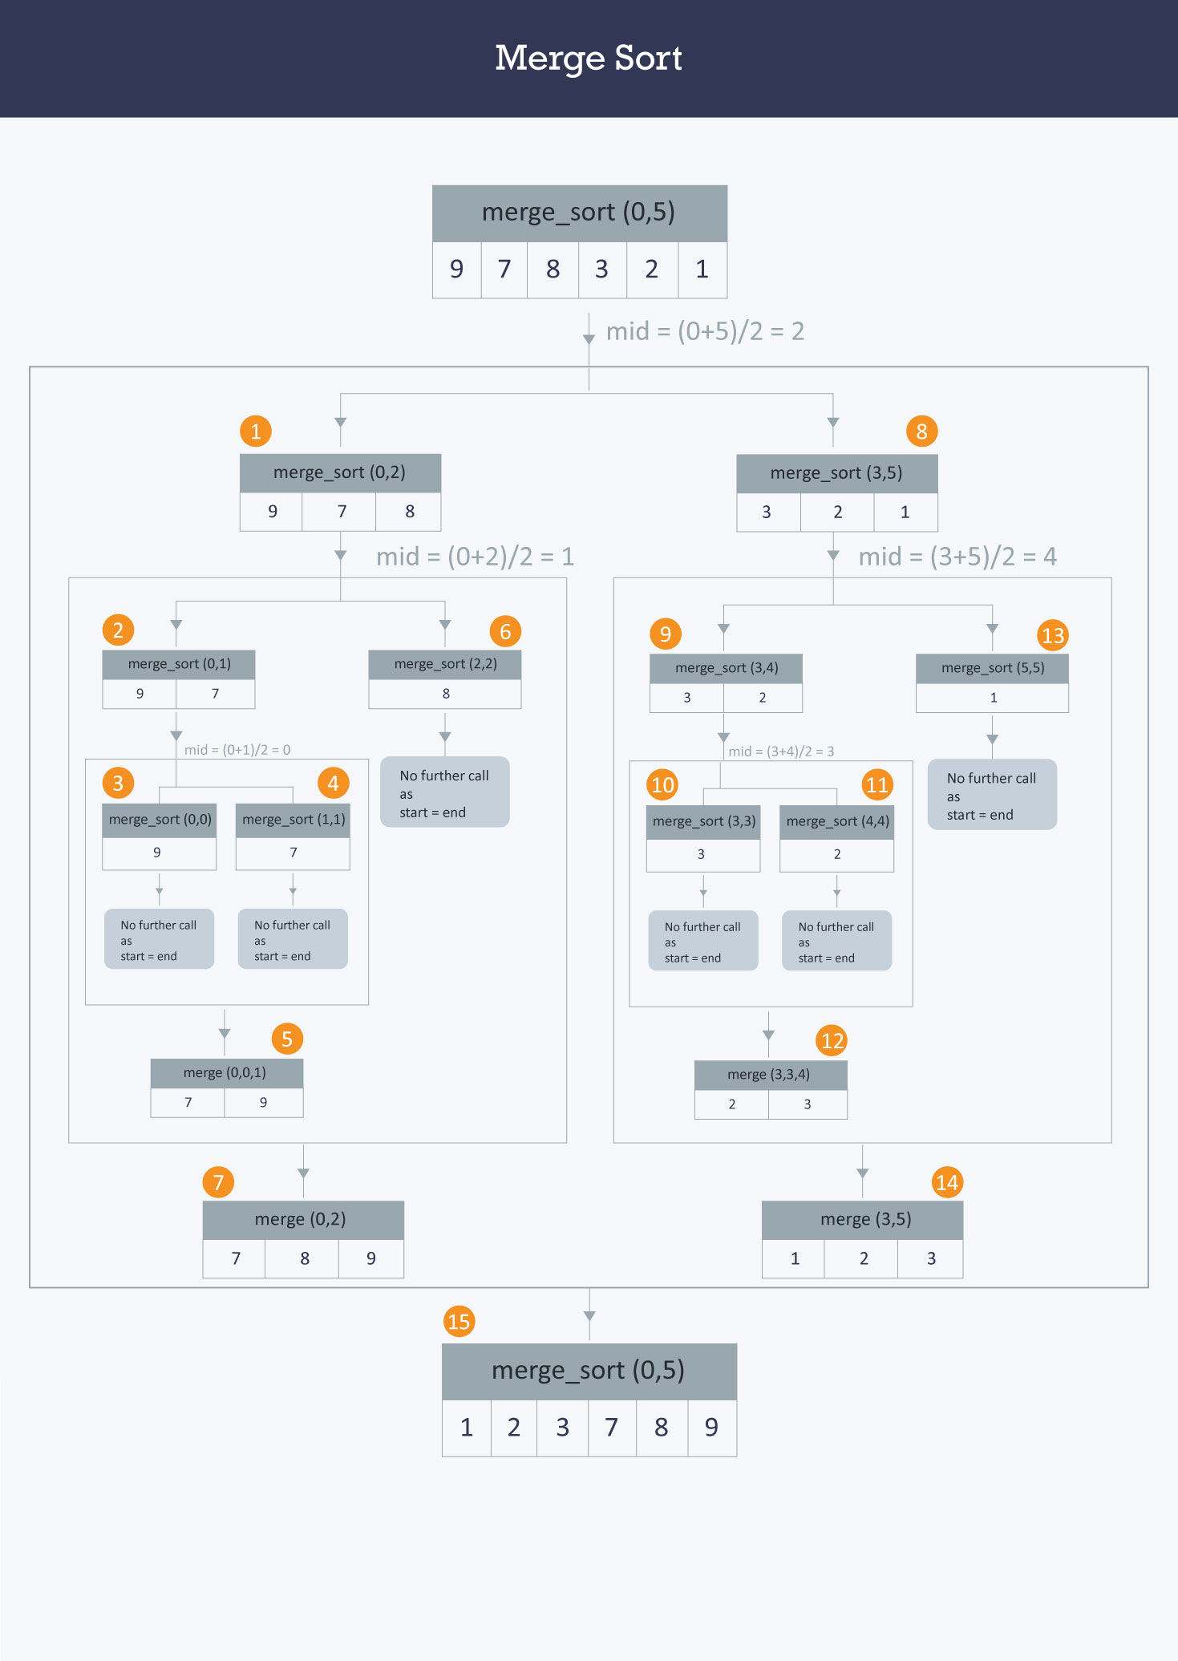

Slide 24
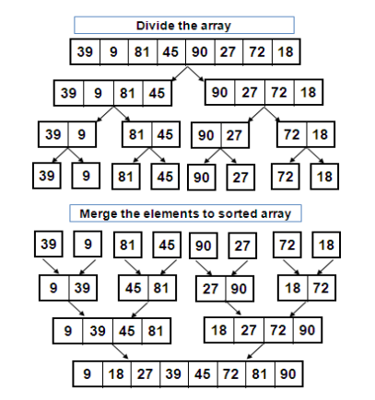
EX: Consider Element are: 39 9 81 45 90 27 72 18
Sorted elements are: 9 18 27 39 45 72 81 90

Slide 25
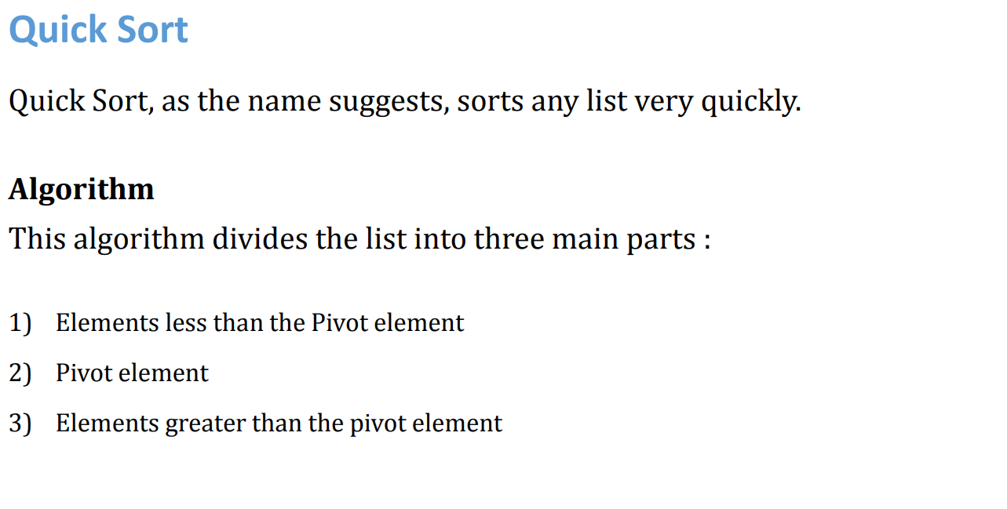

Slide 26
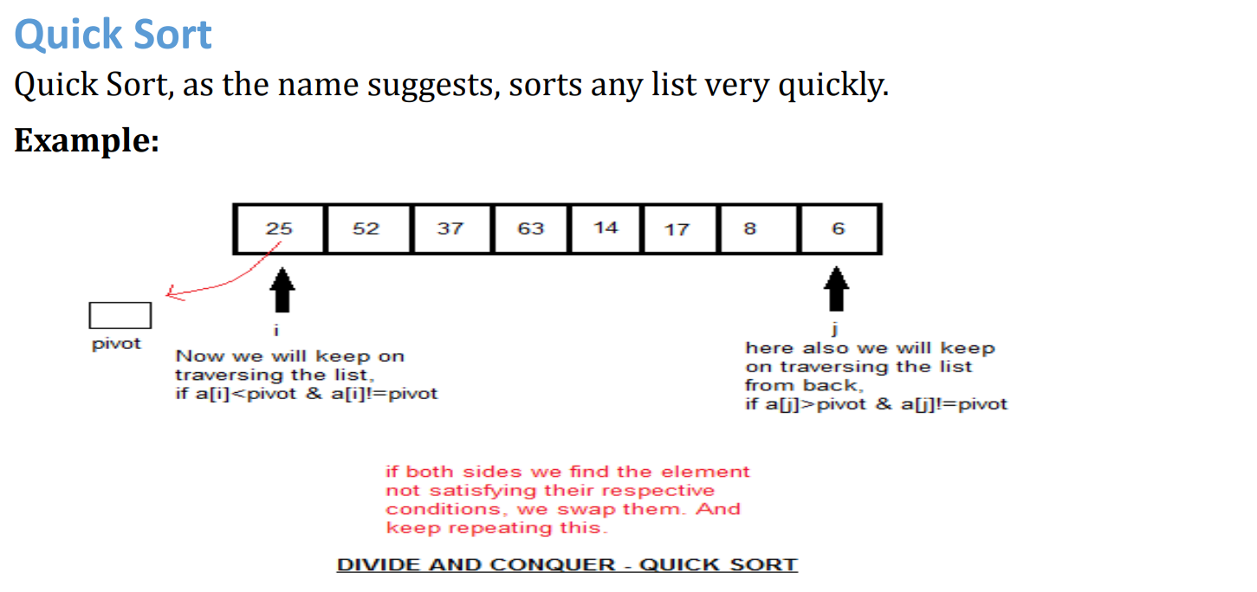

Slide 27
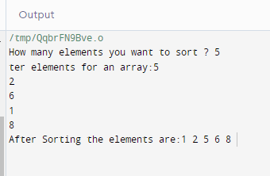
#include<stdio.h>
void quicksort(int[ ],int,int);
void main( )
{
int low, high, pivot, t, n, i, j, a[10];
//clrscr( );
printf("\nHow many elements you want to sort ? ");
scanf("%d",&n);
printf("\Enter elements for an array:");
for(i=0; i<n; i++)
scanf("%d",&a[i]);
low=0;
high=n-1;
quicksort(a,low,high);
printf("\After Sorting the elements are:");
for(i=0;i<n;i++)
printf("%d ",a[i]);
}
void quicksort(int a[ ],int low,int high)
{
int pivot,t,i,j;
if(low<high)
{
pivot=a[low];
i=low+1;
j=high;
while(1)
{
while(pivot>a[i]&&i<=high)
i++;
while(pivot<a[j]&&j>=low)
j--;
if(i<j) {
t=a[i];
a[i]=a[j];
a[j]=t;
}
else
break;
}
a[low]=a[j];
a[j]=pivot;
quicksort(a,low,j-1);
quicksort(a,j+1,high);
}
}

Slide 28
